Slide 1


Bioinformatics in Environmental Research
Ke Yu
Assis. Professor
Spring, 2018

Slide 2
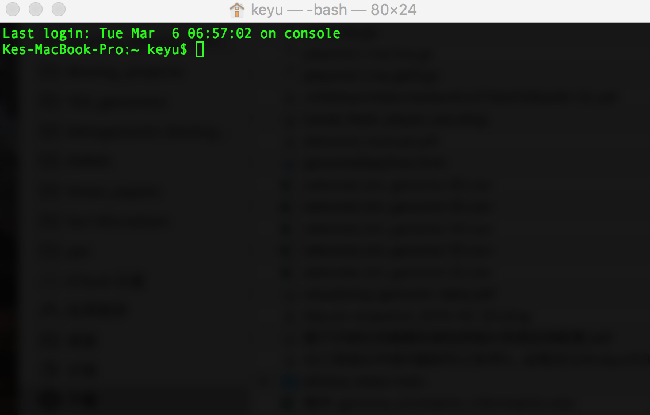
Get Use to Command Line 习惯命令行
Unix (Linux and Mac OS X): Terminal
Windows: CMD
Data Analysis Command Line:
Linux > OS X >>> Windows

Slide 3
makeblastdb –in SSU128_p1_teaching.fa.txt –dbtype nucl –hash_index
blastn –query 02052015_anammox_R1.fastq-l180-q30_p90_R1.fq.fasta.txt –db SSU128_p1_teaching.fa.txt –outfmt 6 –out output.txt –evalue 1e-3 -max_target_seqs 5 –num_threads 2
Notes:
Anammox genome recovered from metagenomics revealed ANAMMOX possess a complete wood-ljungdahl pathway and a reverse citric acid cycle of Krebs to carry out carbon fixation.
Ferredoxin added into the reactor would provide more electrons for bacterial physiological activity. It will especially increase the activity of reduced ferredoxin-dependent enzymes, such as pyruvate synthase and 2-ketoglutarate ferredoxin oxidoreductase, which are two enzymes involved in a reverse citric acid cycle for anaerobic carbon fixation in ANAMMOX genome. The genomic evidence explained the reason Fe2+ would increase the activity of ANAMMOX in the reactor.
Network analysis reveals positive correlation occurred between ANAMMOX and one species in the reactor, indicating the possible interaction among this species. However, the interaction is still unknown. Further experiment will conduct to figure out the bacterial interaction.
What I did is co-occurrence analysis. That’s mean that there was a operational taxonomic unit (OTU) always existence with Brocadia. When the relative abundance of Brocadia increase in the community, the relative abundance of those two OTUs increase. And, if the relative abundance of Brocadia decrease, the relative abundance of the two OTUs decrease as well. The positive correlations indicate those OTUs may be symbiosis. But sometimes the co-occurrence results could be false positive results. So we need to find more evidence from wet lab experiment or dry lab analysis (e.g. metagenomics). The analysis requires at least 25 samples. Right now we have only 10 samples. So the current result should be inaccurate. And, I also need to modify the analysis method after we get new iTag data.

Slide 4
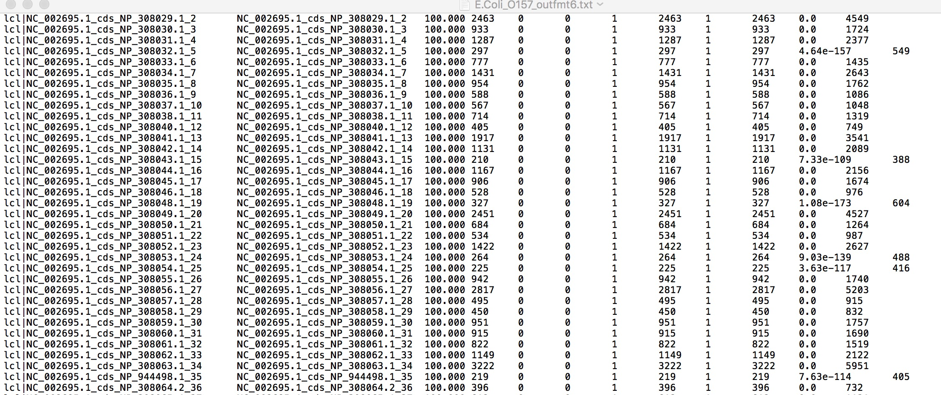
Start BLAST： Outfmt 6

Slide 5
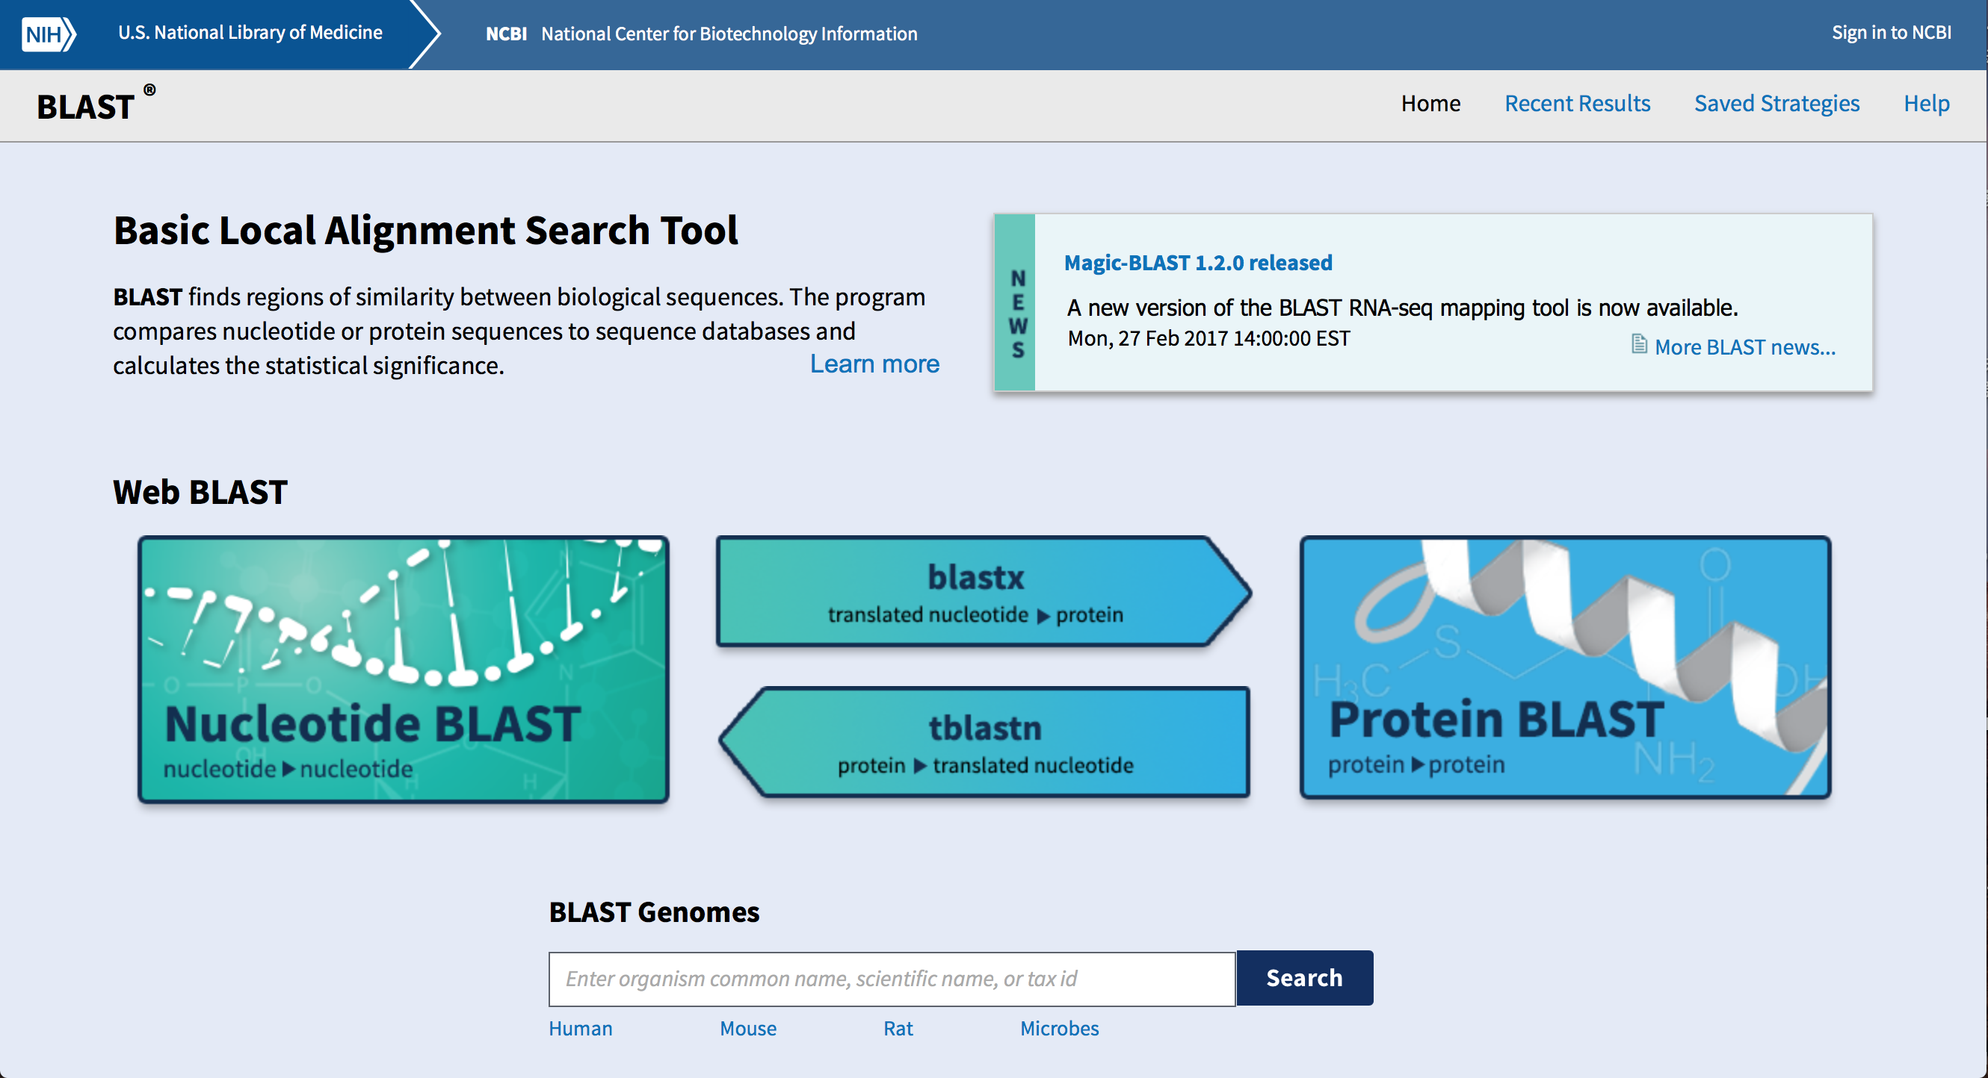
BLAST
https://blast.ncbi.nlm.nih.gov/Blast.cgi

Slide 6
Let’s Try a Real Database
“爱之初体验”
A small sub-database extracted from KEGG database
&
A small 16S rRNA gene database extracted from Silva-SSU database

Slide 7
Let’s Try a Real Database
Query (你自己):
E Coli. Sequence
Which Sequences?
Genomic sequence?
ORFs sequences?
VS. Database (潜在男友或者女友):
KEGG sub-db;
SSU sub-db

Slide 8
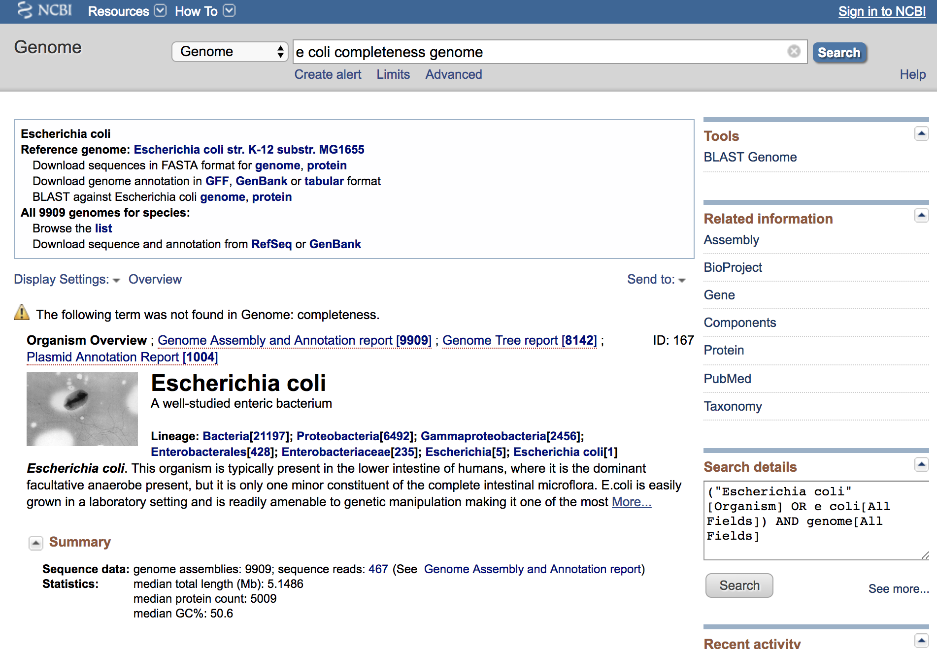
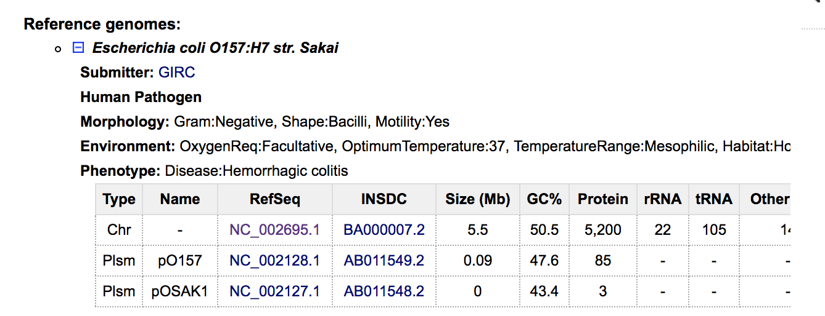
Prepare Your Dataset
https://www.ncbi.nlm.nih.gov/genome/?term=e+coli+completeness+genome

Slide 9
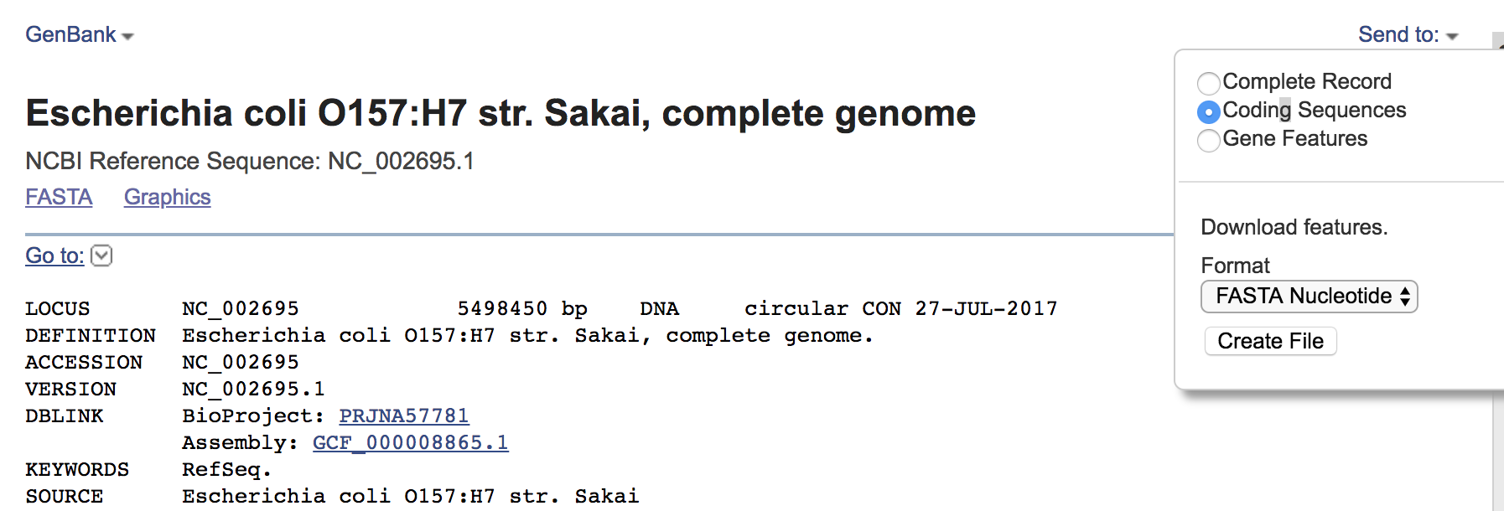
Prepare Your Dataset
https://www.ncbi.nlm.nih.gov/nuccore/NC_002695.1

Slide 10
Question 1. How Could You Find the 16S rRNA Gene Sequence?
ORFs? Genomic Sequences? Why?
了解你自己（你的目标序列）
Q1: 16S rRNA gene + ncRNA etc. 和ORFs的区别

Slide 11
Question 2. How is the Speed of BLAST using AA database (e.g. KEGG db)?
“爱之初体验”之速度
BLAST识别“爱人”的速度实在太慢
Why?
BLAST是现在用的最准确的比对软件之一，
所以速度慢就成必然

Slide 12
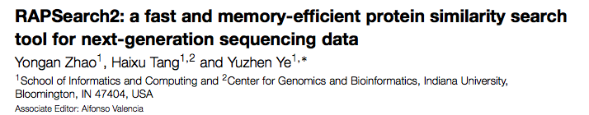
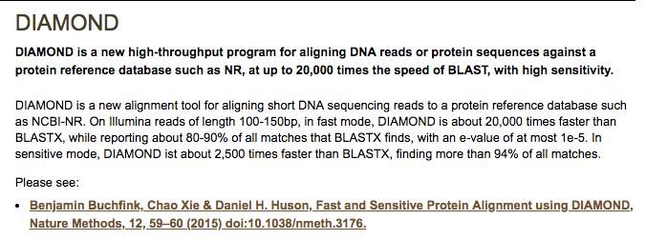
（广告词）速度太慢，怎么办？
http://omics.informatics.indiana.edu/mg/RAPSearch2/
https://ab.inf.uni-tuebingen.de/software/diamond/

Slide 13
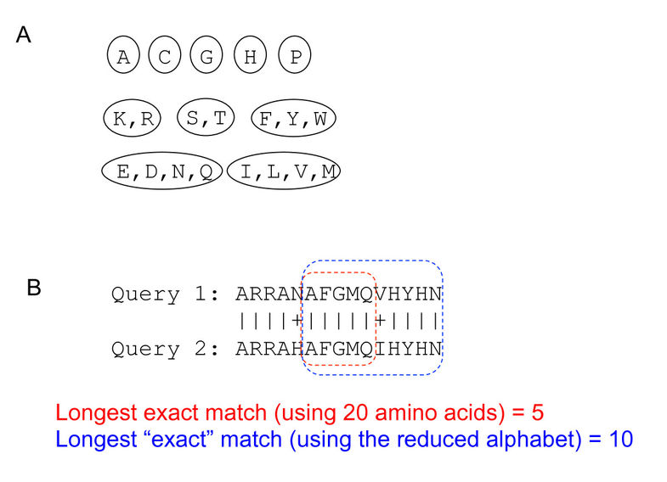
RAPSearch
氨基酸的相似性
R • Lysine - Lys - K • Aspartic acid - As
速度提高20-90X；可找出BLAST找出的86~98%的序列

Slide 14
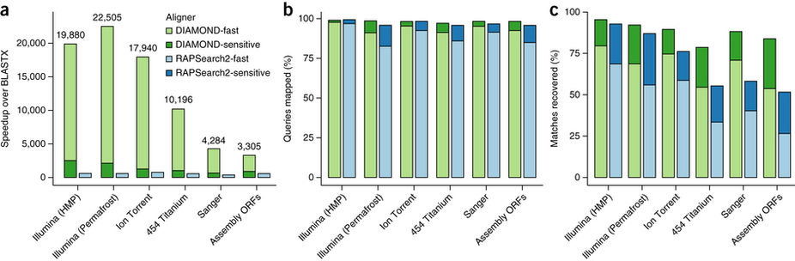
DIAMOND
Reduced alphabet：
[KREDQN] [C] [G] [H] [ILV] [M] [F]
[Y] [W] [P] [STA].
普通模式，提速20,000倍，获取70-80%的序列
在sensitive mode下提速约2500倍，获取94%的序列

Slide 15
BLAST VS. RAPSearch and Diamond
导入数据库均为fasta格式的文件
RAPSearch及Diamond只接受氨基酸（aa）数据库
BLAST可接受包括核苷酸及氨基酸数据库
三者的数据库格式不同，不可以通用，运行命令也不同

Slide 16
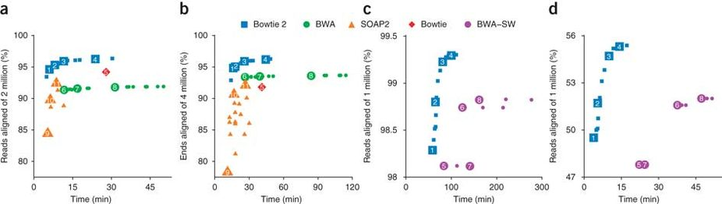
Aligner with High Accuracy 只针对高相似度序列进行比对的软件
Bowtie2, Bowtie, BWA, MAPQ, etc.

Slide 17
Aligner with High Accuracy 只针对高相似度序列进行比对的软件
Bowtie2, Bowtie, BWA, MAPQ, Tophat, etc.

Slide 18
Aligner with High Accuracy 只针对高相似度序列进行比对的软件
Bowtie2, Bowtie, BWA, MAPQ, Tophat, etc.

Slide 19
Aligner with High Accuracy 只针对高相似度序列进行比对的软件
Tophat-Cufflinks: 真核生物有intron?记得什么是intron?

Slide 20
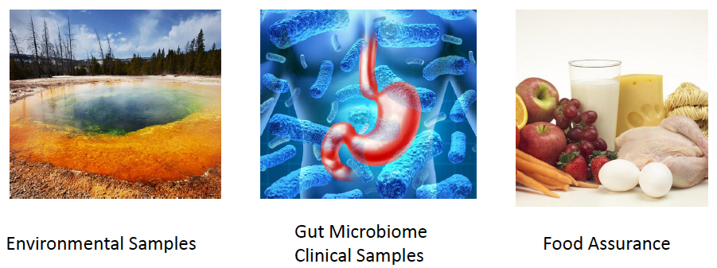
Environmental Studies
Microbial Community Structure
Silva db, RDP db, etc.
Gene Function Classification
Refprot, NCBI-nr, KEGG, COG, etc.

Slide 21
测序的技术的差异

Slide 22
测序的技术的差异

Slide 23
大多数情况为单一序列

Slide 24
Illumina
测序在多数情况下为双端序列

Slide 25
3rd Generation of Sequencing: PacBio Sequencing

Slide 26
3rd Generation of Sequencing: Nanopore Sequencing

Slide 27
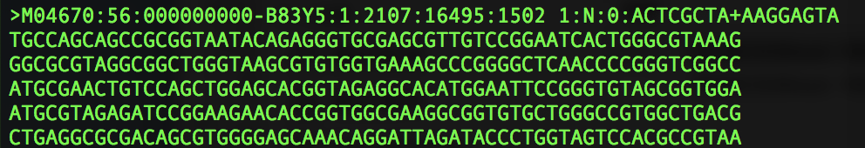
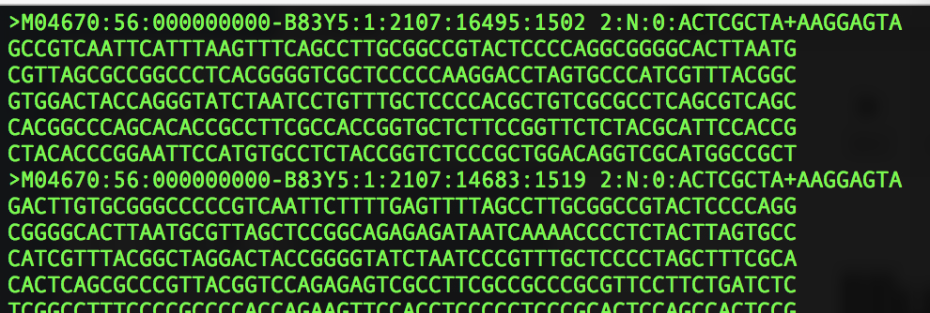
Illumina: Paired-End Sequencing 双端测序
Read1 and Read 2

Slide 28
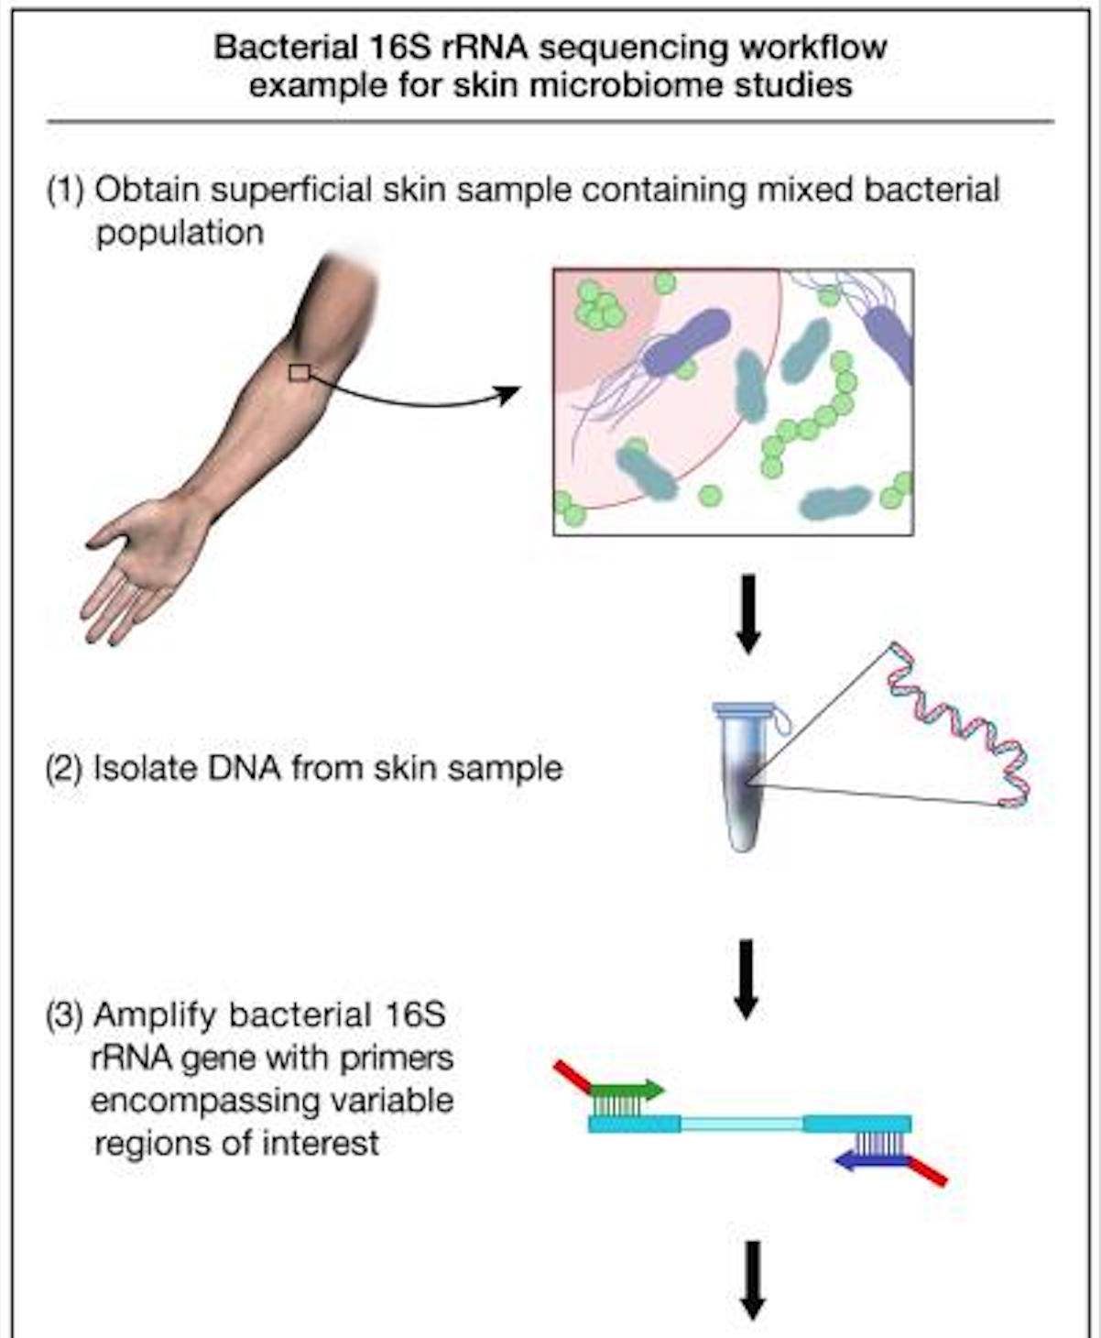
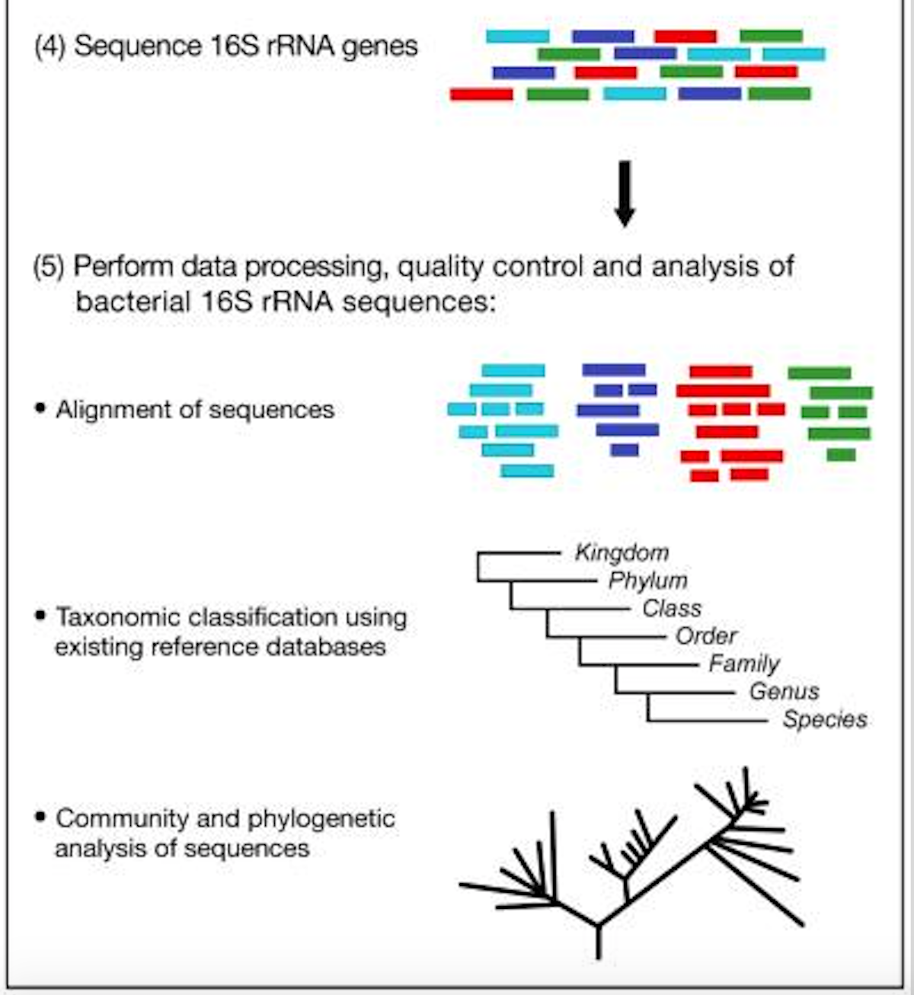
Example Procedure of Sampling, Sequencing and Analysis

Slide 29
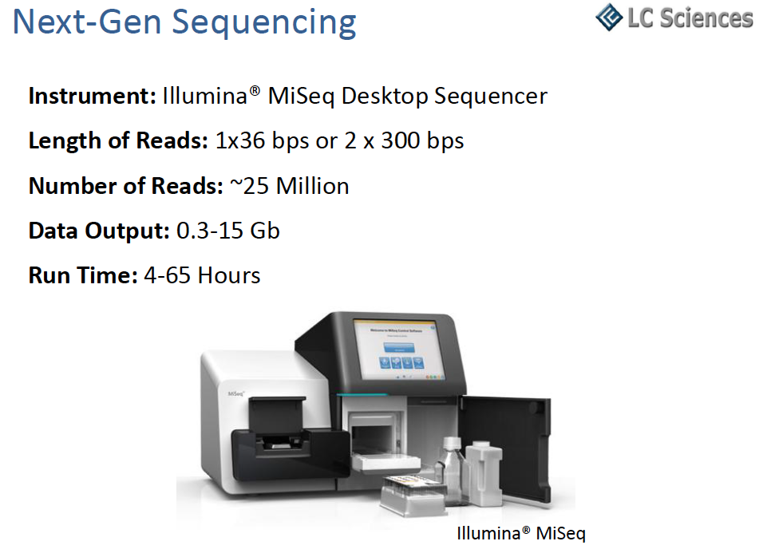
Obtain Your Data

Slide 30
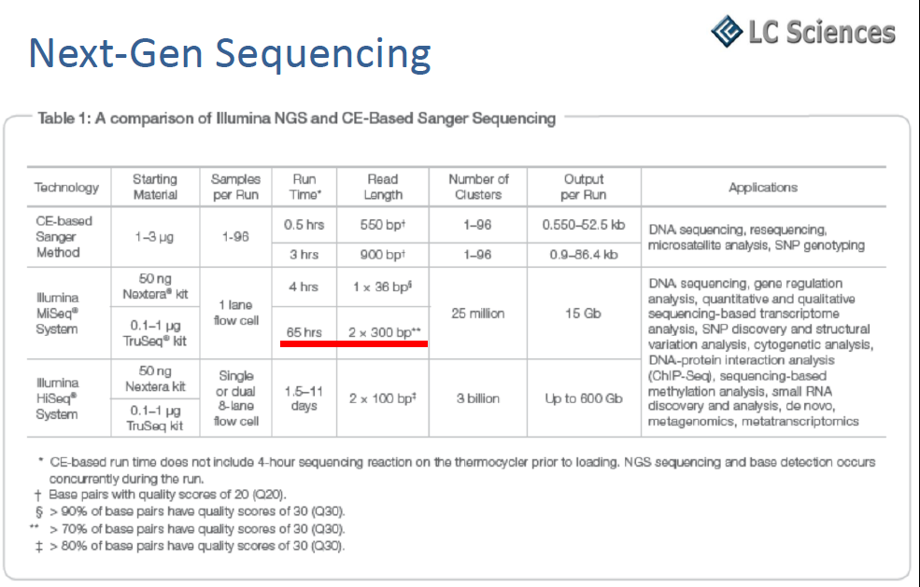

Slide 31
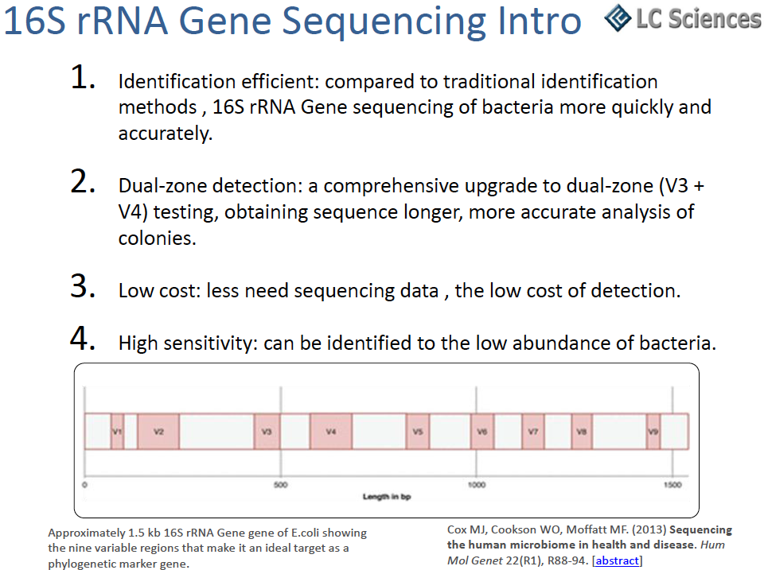

Slide 32
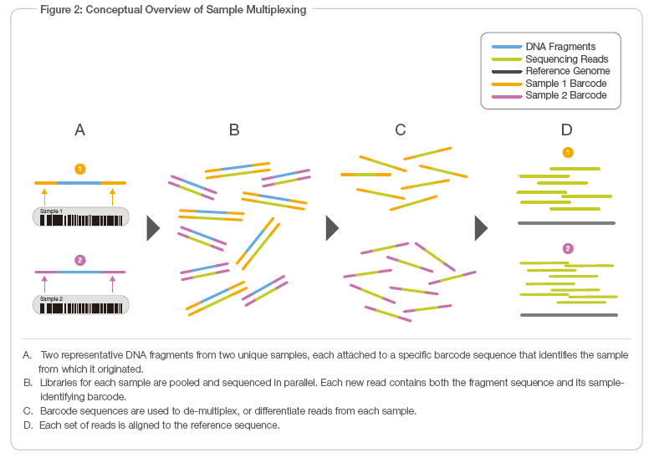

Slide 33
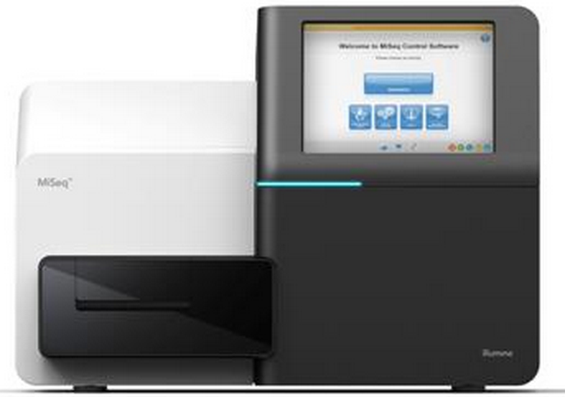
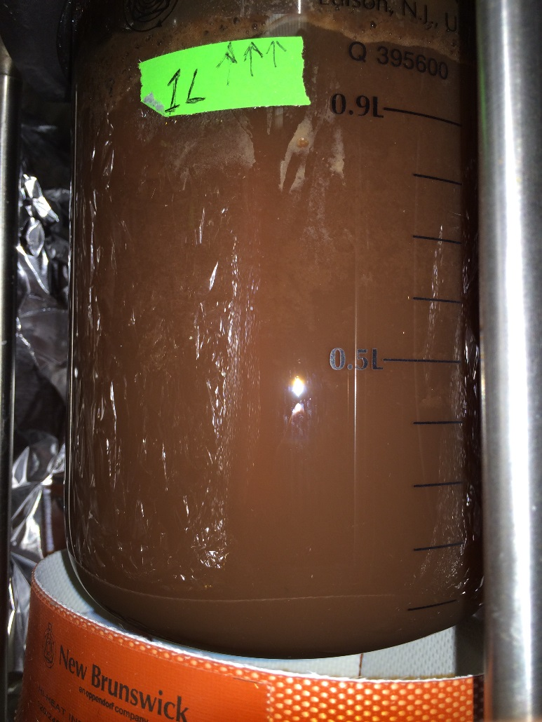
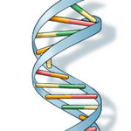
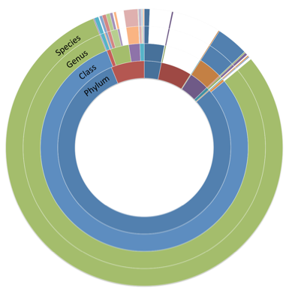
Procedure
DNA/RNA extraction
Sampling
PCR
Miseq sequencing
CTGAACTCCTACGGGTAG …
CTGAACAGCTAGTCGGCG …
AGAGATTGCGATTACATC …
AGAGATTTTCAGTGGGCG …
TTAGGCTCTCTAGGGGCC …
TTAGGCAACGTGCAGTCA …
…
Visualization
Database annotation
Sequence data

Slide 34
iTag:
DNA or cDNA samples (low concentration will be ok)
200 – 300 samples for each run (~$2000-3000)
Prepare barcodes

Slide 35
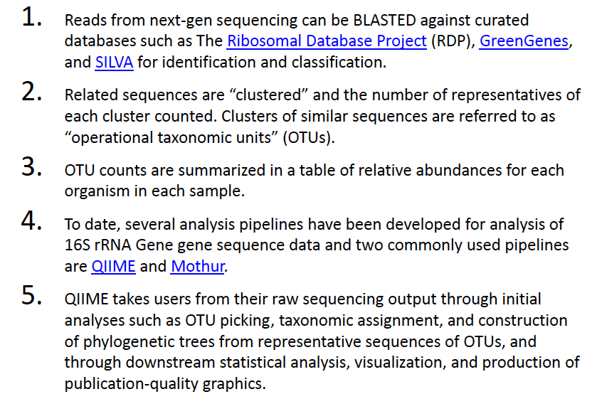
Procedure

Slide 36
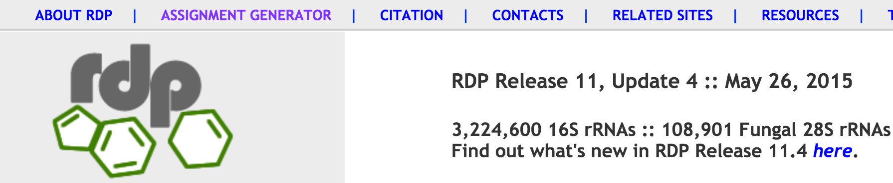

RDP (https://rdp.cme.msu.edu/)
1st step
2nd Step

Slide 37
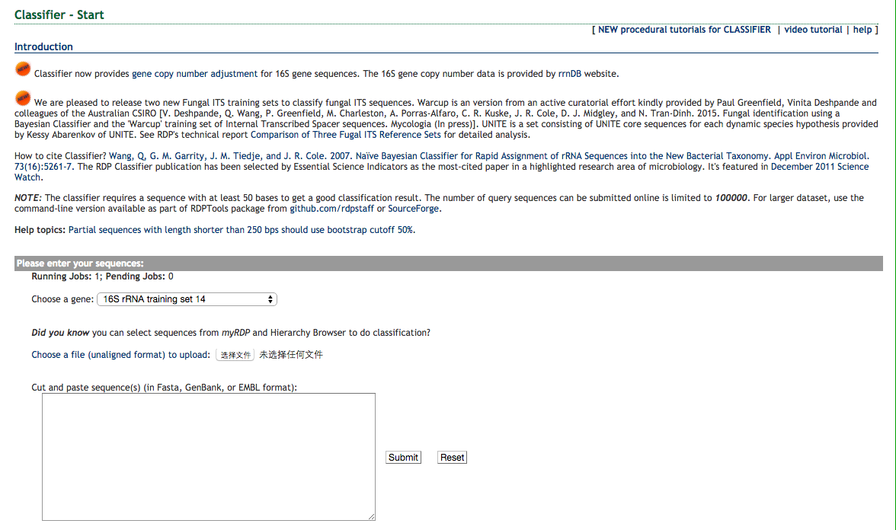
RDP (https://rdp.cme.msu.edu/)
3rd step

Slide 38
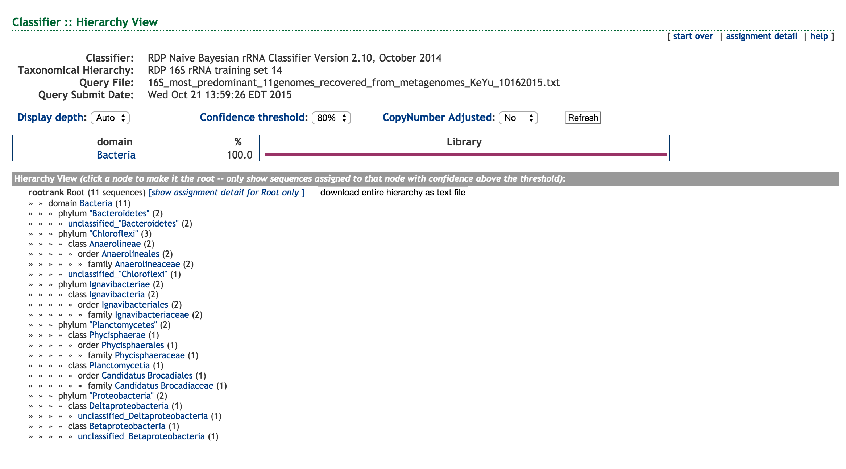
RDP (https://rdp.cme.msu.edu/)
Results

Slide 39
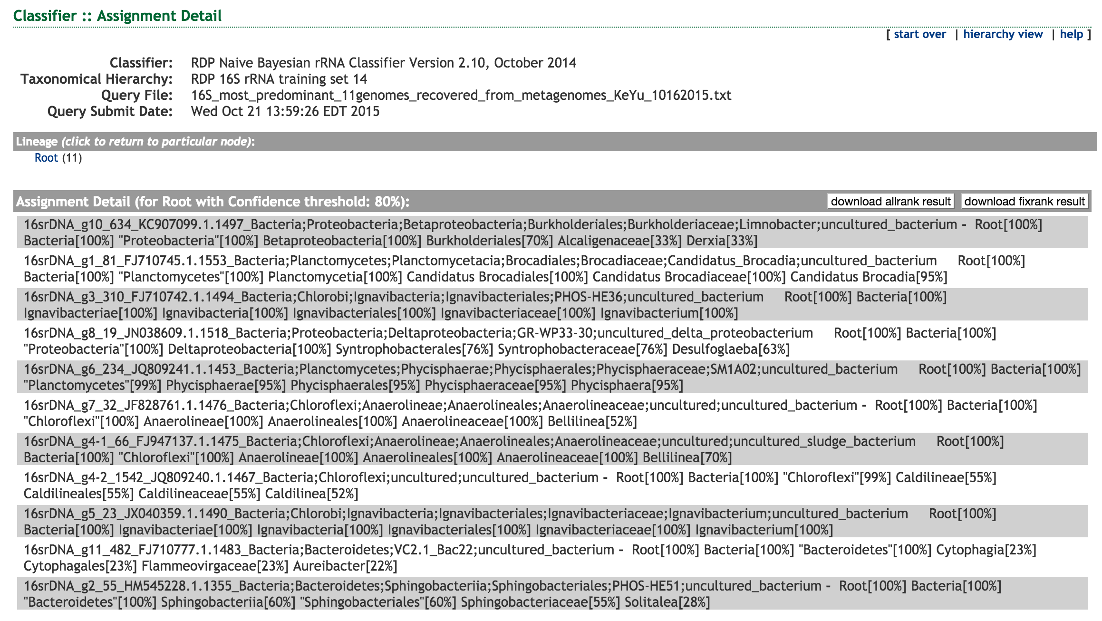
RDP (https://rdp.cme.msu.edu/)
Results

Slide 40
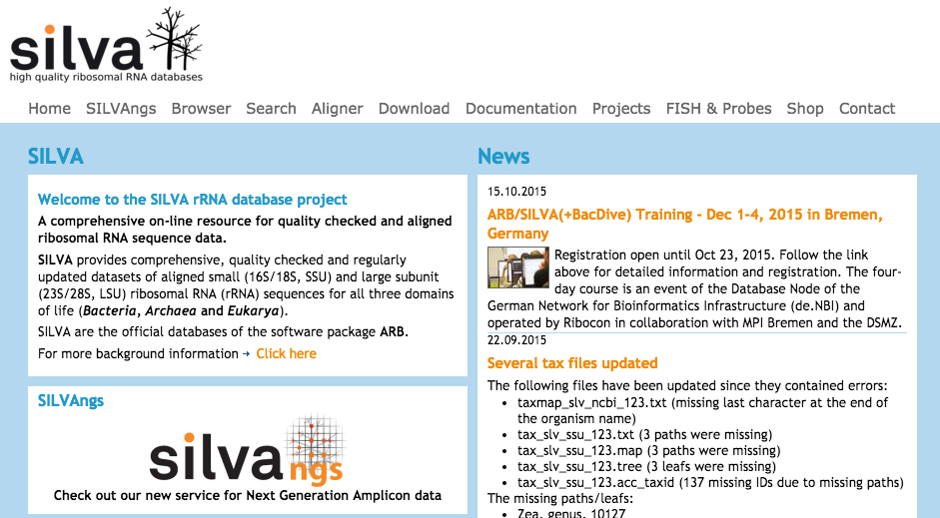
Silva Database (http://www.arb-silva.de/)

Slide 41
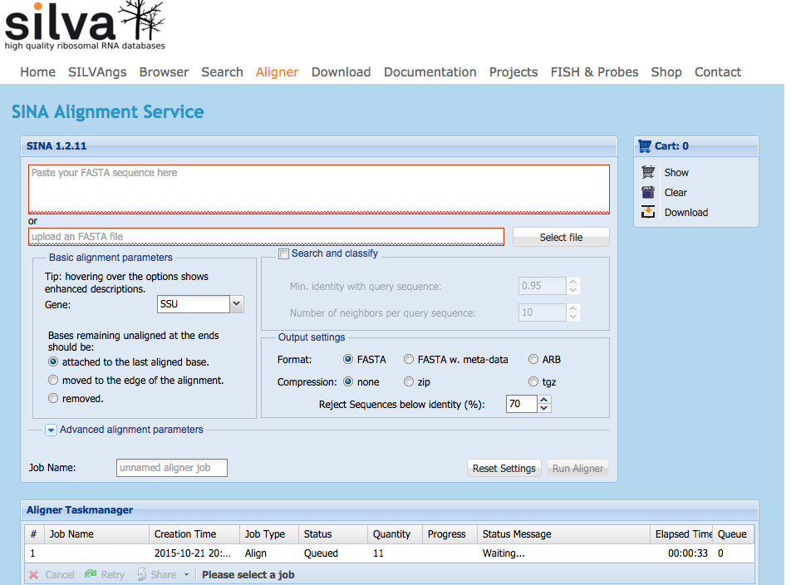
Silva Online Server (http://www.arb-silva.de/aligner)

Slide 42
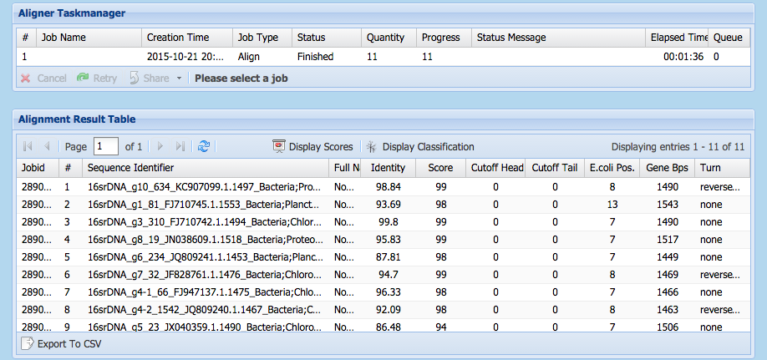
Silva Online Server (http://www.arb-silva.de/aligner)

Slide 43
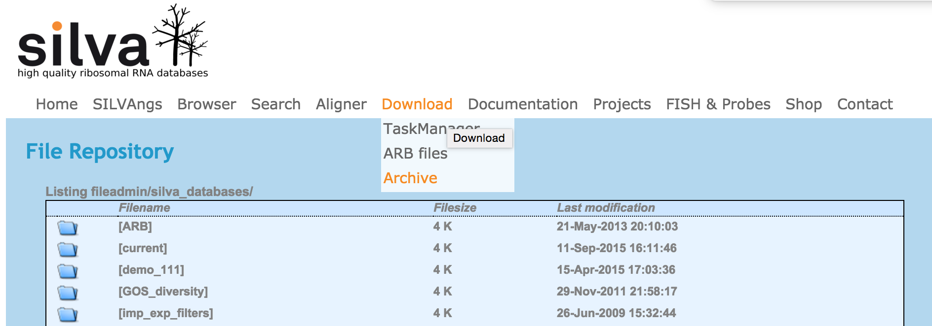
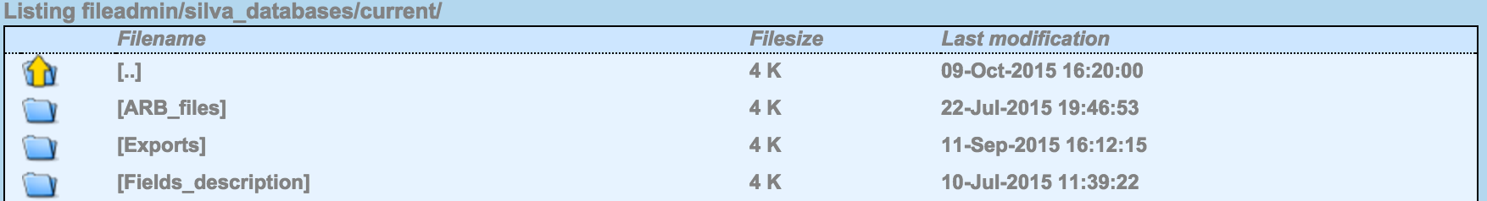
Local Annotation of Query Against Silva Database
1st step download database

Slide 44
Local Annotation of Query Against Silva Database
1st step download database

Slide 45
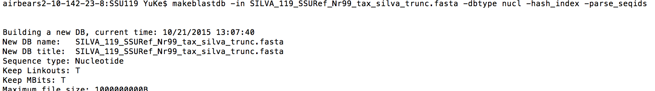
Local Annotation of Query Against Silva Database
2nd step format database and blast
Format the database:
Open a terminal in Linux or Mac OS X
Type the following command:
> makeblastdb –in database.fa –dbtype nucl –hash_index -parse_seqids
BLAST:
> blastn –query your_query_file –db database_file –evalue cutoff –outfmt 6 -num_threads 6 –max_target_seqs 10 –out output_file_name

Slide 46
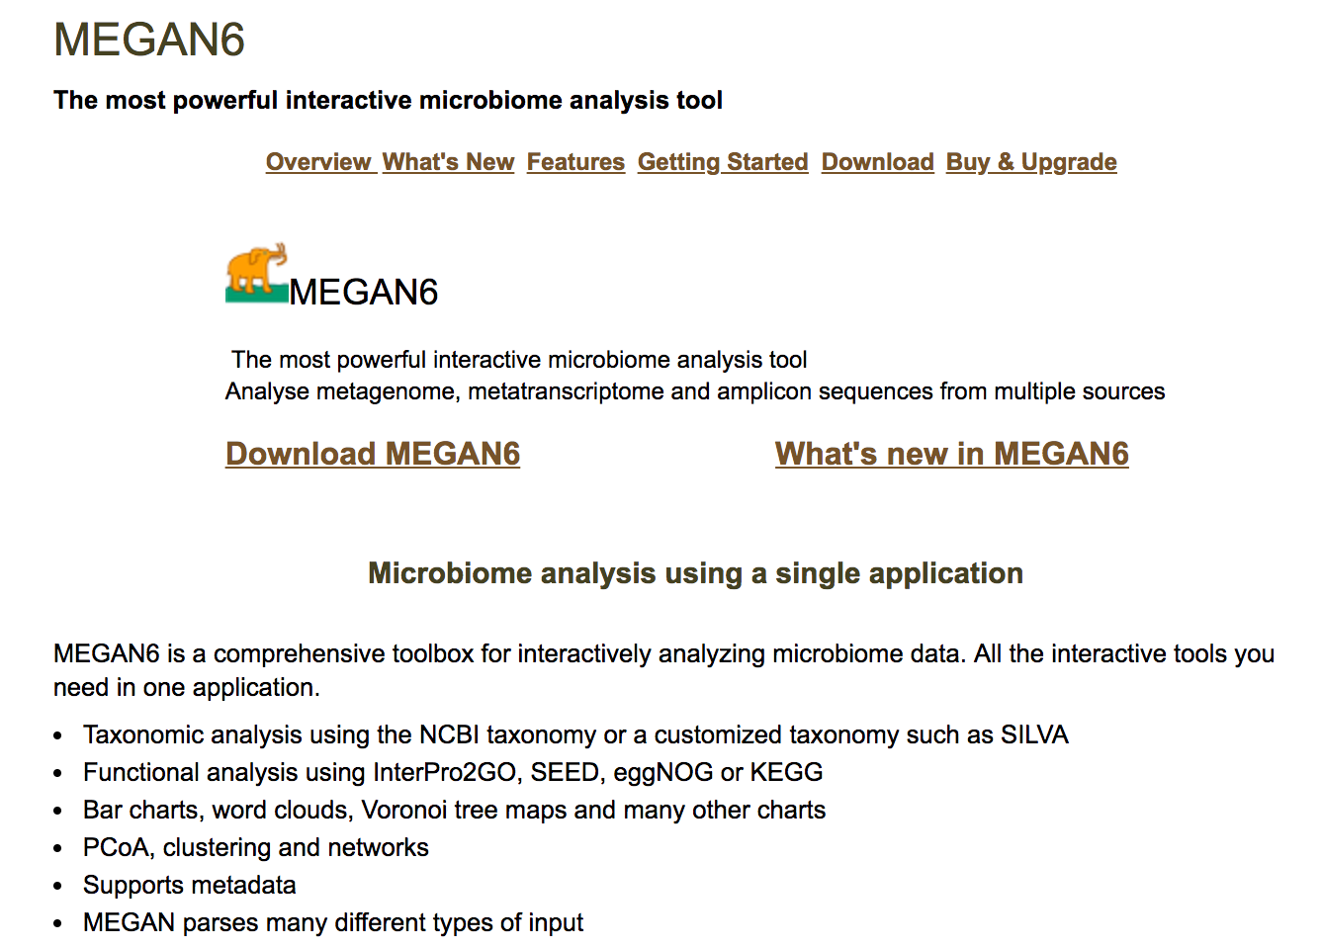
Local Annotation of Query Against Silva Database
3rd step visualization (MEGAN http://ab.inf.uni-tuebingen.de/software/megan6/)

Slide 47
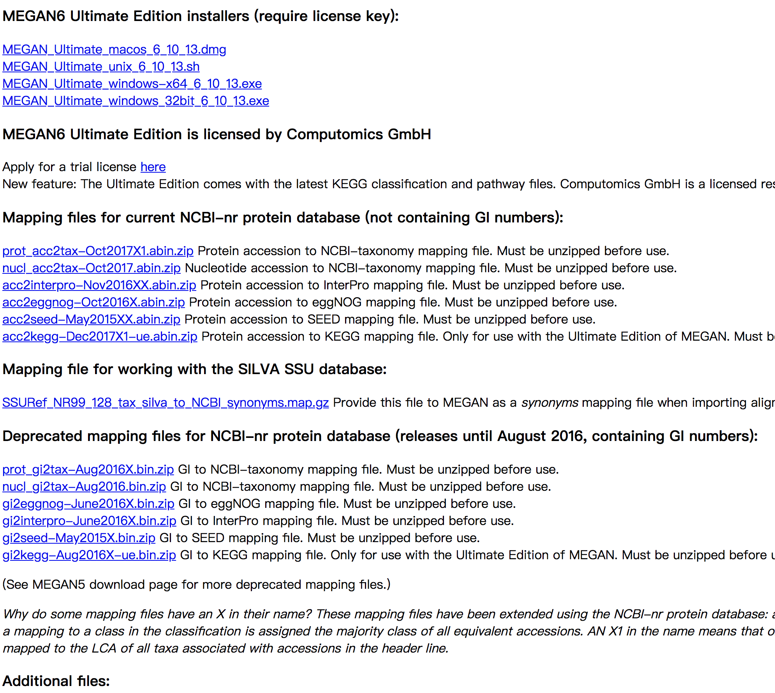
Local Annotation of Query Against Silva Database

Slide 48
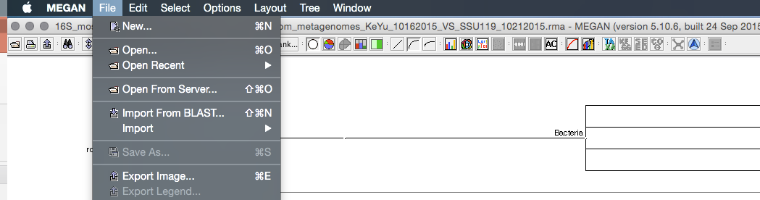
Local Annotation of Query Against Silva Database
3rd step visualization

Slide 49
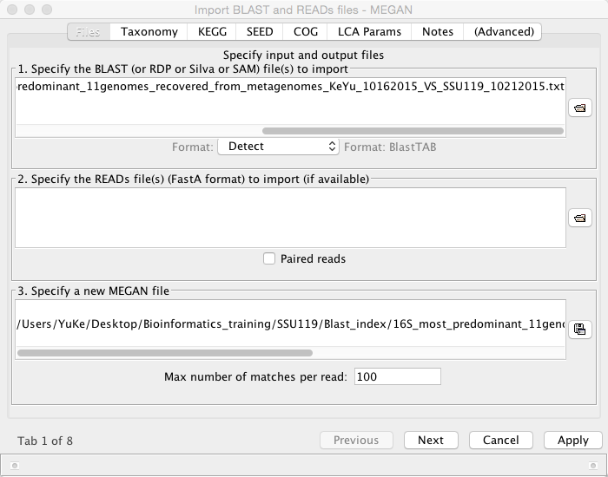
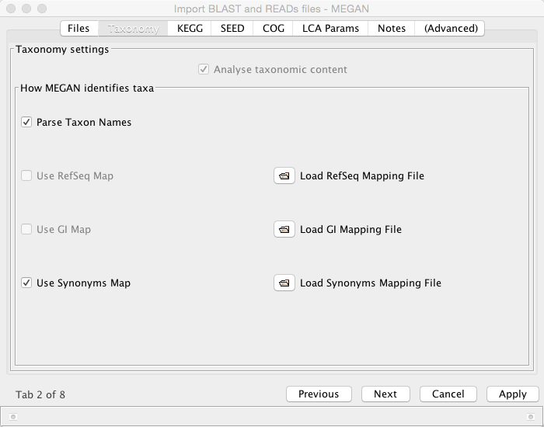
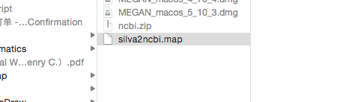
Local Annotation of Query Against Silva Database
3rd step visualization

Slide 50
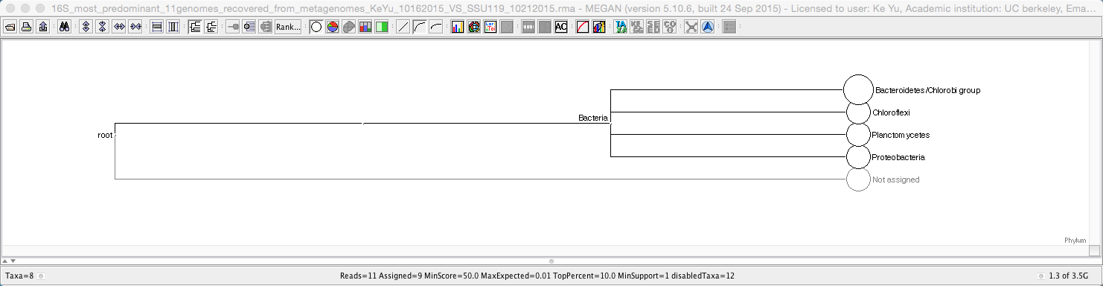
Local Annotation of Query Against Silva Database
3rd step visualization

Slide 51
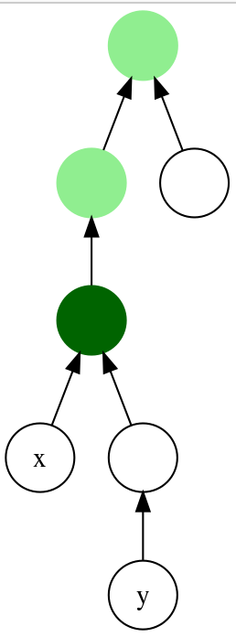
Lowest common ancestor (LCA)
In graph theory and computer science, the lowest common ancestor (LCA) of two nodes v and w in a tree or directed acyclic graph (DAG) is the lowest (i.e. deepest) node that has both v and w as descendants, where we define each node to be a descendant of itself (so if v has a direct connection from w, w is the lowest common ancestor).
The LCA of v and w in T is the shared ancestor of v and w that is located farthest from the root. Computation of lowest common ancestors may be useful, for instance, as part of a procedure for determining the distance between pairs of nodes in a tree: the distance from v to w can be computed as the distance from the root to v, plus the distance from the root to w, minus twice the distance from the root to their lowest common ancestor (Djidjev, Pantziou & Zaroliagis 1991). In ontologies, the lowest common ancestor is also known as the least common subsumer.
In a tree data structure where each node points to its parent, the lowest common ancestor can be easily determined by finding the first intersection of the paths from v and w to the root. In general, the computational time required for this algorithm is O(h) where h is the height of the tree (length of longest path from a leaf to the root). However, there exist several algorithms for processing trees so that lowest common ancestors may be found more quickly. Tarjan's off-line lowest common ancestors algorithm, for example, preprocesses a tree in linear time to provide constant-time LCA queries. In general DAGs, similar algorithms exist, but with super-linear complexity.
In this tree, the LCA o the nodes x and y is marked in dark green. Other common ancestors are shown in light green.
http://en.wikipedia.org/wiki/Lowest_common_ancestor

Slide 52
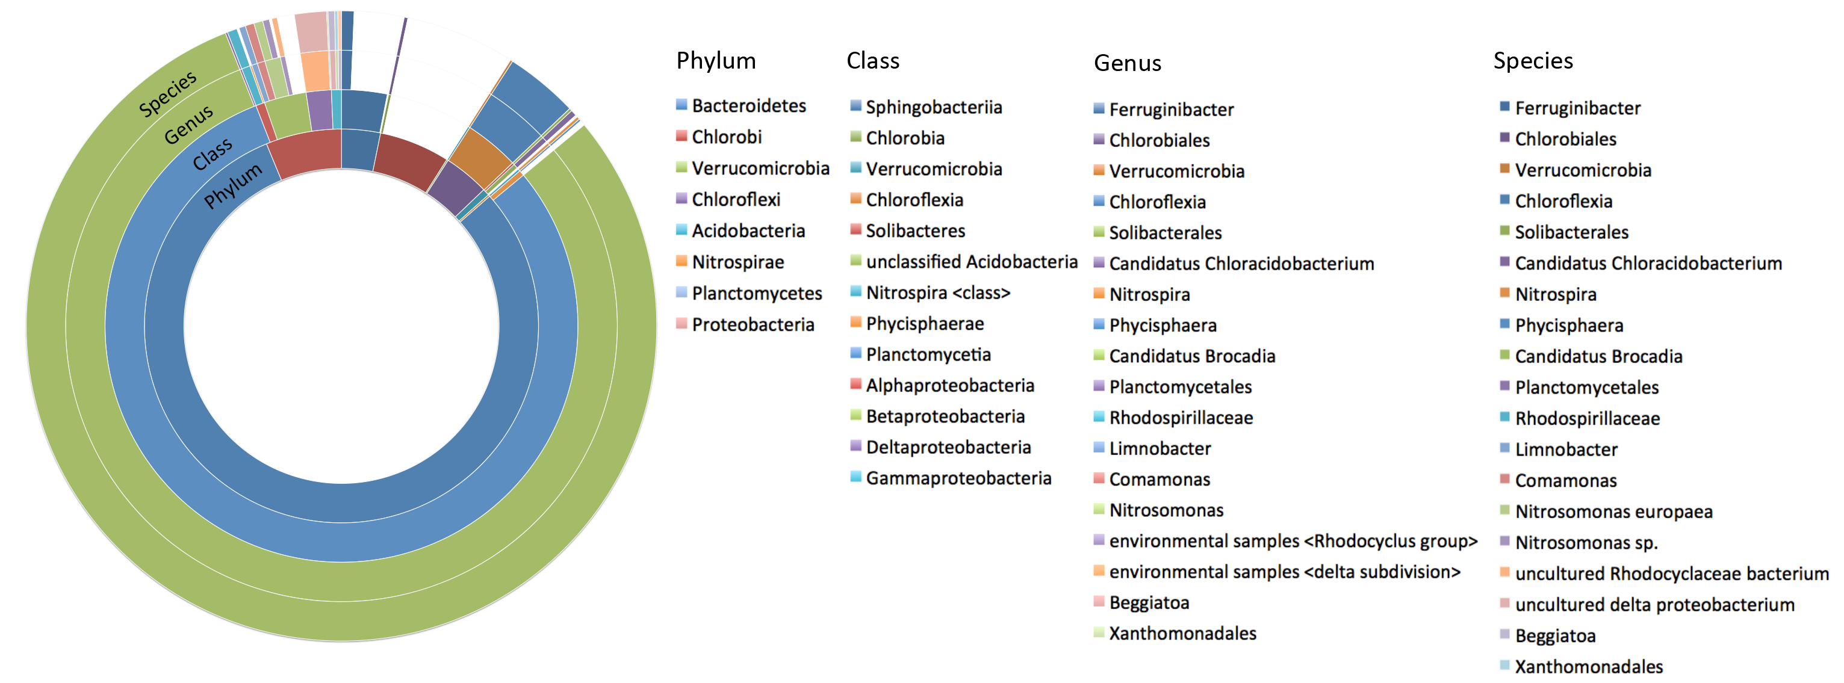
Dominant taxon in anammox community
Dominant taxon | Relative percentage in total sequenced 16S rRNA gene sequences (%)
Candidatus Brocadia | 79.1
Chlorobi (class) | 5.8
Uncultured Chloroflexia bacterium | 3.7
Sphingobacteriales (class) | 3.1
Uncultured delta proteobacterium | 1.1
16S rRNA gene annotation was carried out by lowest common ancestor algorithm.
Taxa with related percentage higher than 1% were selected and presented in the table.

Slide 53
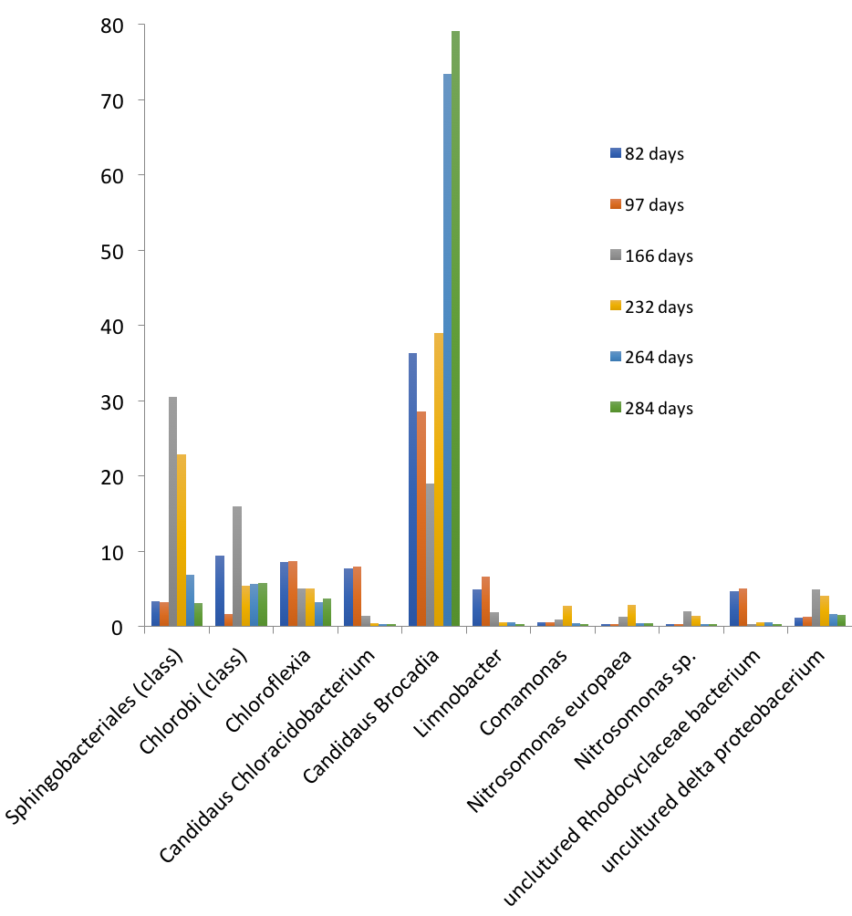
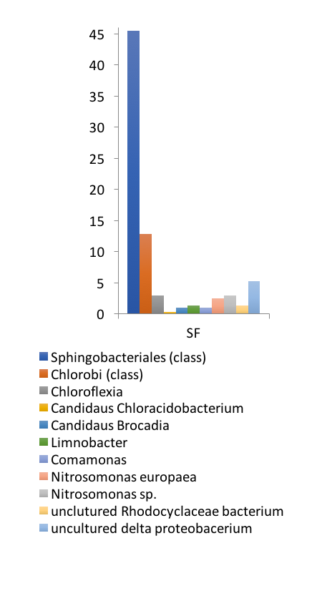
Anammox community shifting during enrichment
Relative percentage of 16S rRNA gene abundance in anammox community (%)
Relative percentage of 16S rRNA gene abundance in anammox community (%)

Slide 54
Supporting information

Slide 55
Local Annotation of Query Against Silva Database
3rd step visualization

Slide 56
Local Annotation of Query Against Silva Database
3rd step visualization

Slide 57
Local Annotation of Query Against Silva Database

